Slide 1
Interfaces in Java
In the Java programming language, an interface is a reference type, similar to a class.
Interface can contain only
Constants
Method signatures [No method body]
Default methods [Method bodies exist]
Static methods [Method bodies exist]
Nested types
Interfaces cannot be instantiated—they can only be implemented by classes or extended by other interface

Slide 2
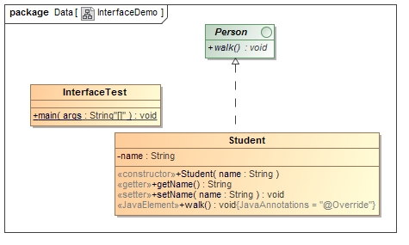
Interfaces in Java

Slide 3
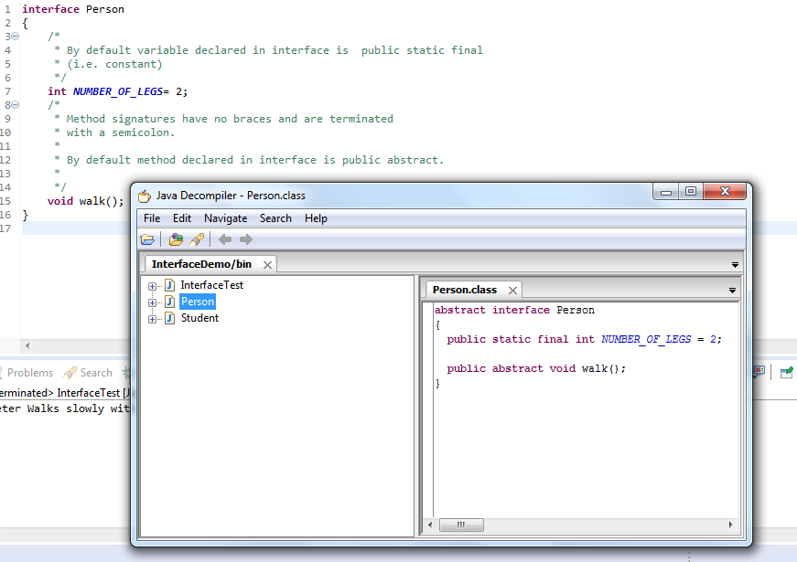
Interfaces in Java

